Slide 1


Mark Daniel g. Dacer

Slide 2

Access Modifier

Slide 3
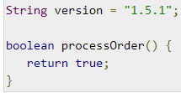
Default Access Modifier - No Keyword
Default access modifier means we do not explicitly declare an access modifier for a class, field, method, etc.
A variable or method declared without any access control modifier is available to any other class in the same package. The fields in an interface are implicitly public static final and the methods in an interface are by default public.

Slide 4
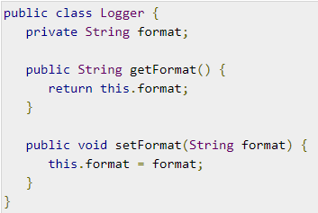
Private Access Modifier - Private
Methods, variables, and constructors that are declared private can only be accessed within the declared class itself.
Private access modifier is the most restrictive access level. Class and interfaces cannot be private.
Variables that are declared private can be accessed outside the class, if public getter methods are present in the class.
Using the private modifier is the main way that an object encapsulates itself and hides data from the outside world.

Slide 5

Public Access Modifier - Public
A class, method, constructor, interface, etc. declared public can be accessed from any other class. Therefore, fields, methods, blocks declared inside a public class can be accessed from any class belonging to the Java Universe.
However, if the public class we are trying to access is in a different package, then the public class still needs to be imported. Because of class inheritance, all public methods and variables of a class are inherited by its subclasses.

Slide 6
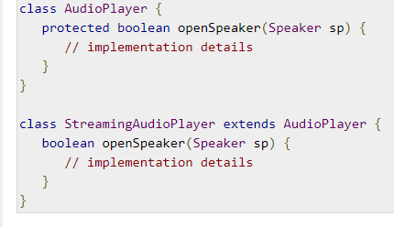
Protected Access Modifier - Protected
Variables, methods, and constructors, which are declared protected in a superclass can be accessed only by the subclasses in other package or any class within the package of the protected members' class.
The protected access modifier cannot be applied to class and interfaces. Methods, fields can be declared protected, however methods and fields in a interface cannot be declared protected.
Protected access gives the subclass a chance to use the helper method or variable, while preventing a nonrelated class from trying to use it.

Slide 7

Conditional Statements

Slide 8
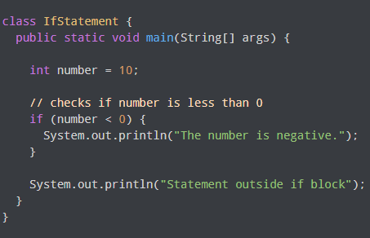
Java if (if-then) Statement
Here, condition is a boolean expression such as age >= 18.
if condition evaluates to true, statements are executed
if condition evaluates to false, statements are skipped
In the program, number < 0 is false. Hence, the code inside the parenthesis is skipped.

Slide 9
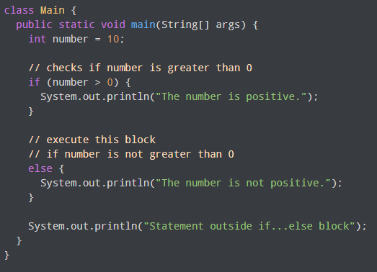
Java if...else (if-then-else) Statement
The if statement executes a certain section of code if the test expression is evaluated to true. However, if the test expression is evaluated to false, it does nothing.
In this case, we can use an optional else block. Statements inside the body of else block are executed if the test expression is evaluated to false. This is known as the if-...else statement in Java.

Slide 10
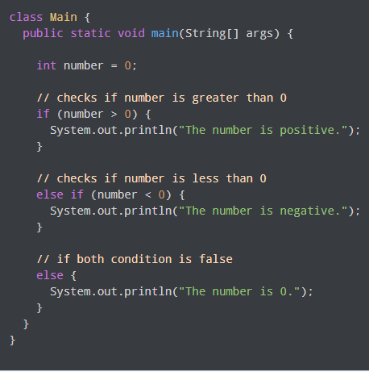
Java if...else...if Statement
In Java, we have an if...else...if ladder, that can be used to execute one block of code among multiple other blocks.

Slide 11

Switch Statements

Slide 12
Switch Statements
The switch statement allows us to execute a block of code among many alternatives.
How does the switch-case statement work?
  The expression is evaluated once and compared with the values of each case.
    If expression matches with value1, the code of case value1 are executed. Similarly, the code of case value2 is executed if expression matches with value2.
    If there is no match, the code of the default case is executed.

Slide 13
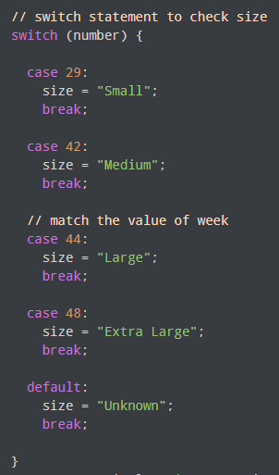
example, we have used the switch statement to find the size. Here, we have a variable number. The variable is compared with the value of each case statement.
Since the value matches with 44, the code of case 44 is executed.

Slide 14
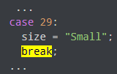
break statement in Java switch...case
Notice that we have been using break in each case block.
The break statement is used to terminate the switch-case statement. If break is not used, all the cases after the matching case are also executed.

Slide 15
Additional Learning Links
Controlling Access to Members of a Class - https://docs.oracle.com/javase/tutorial/java/javaOO/accesscontrol.html
Java If ... Else - https://www.w3schools.com/java/java_conditions.asp

